Slide 1

My Linear Relationships Interactive Notebook
Name
Class
Term 3 Semester 2

Slide 2
Contents
Formula Page
Page
Date
Description
2
3

Slide 3
Tasks
24
7
30
Essential Question
Questions
Notes
Summary
4
5

Slide 4
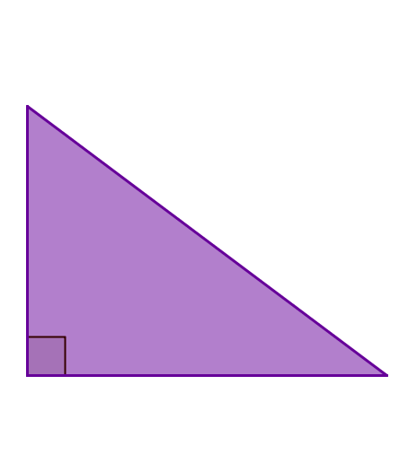
24
7
30
Date
Pythagoras Theorem
EQ – How do I use Pythagoras theorem to find the lengths in a right angled triangle?
The longest side in a right angled triangle is called the hypotenuse. (Opposite the right angle)
Hypotenuse
5

Slide 5
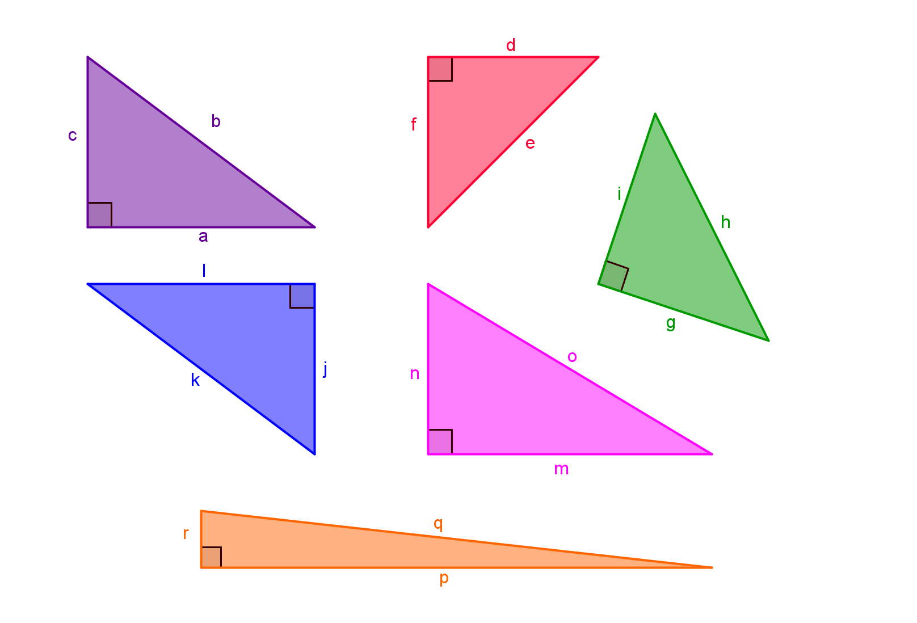
Task-Which side is the hypotenuse?
1)
2)
3)
4)
5)
6)

Slide 6
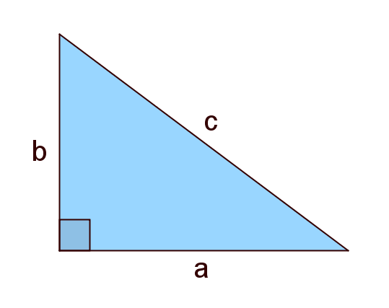

24
7
30
Date
Pythagoras Theorem
EQ – How do I use Pythagoras theorem to find the lengths in a right angled triangle?
The longest side in a right angled triangle is called the hypotenuse. (Opposite the right angle)
Hypotenuse
Pythagoras Theorem states
$$a^{2}+b^{2}=c^{2}$$
5

Slide 7
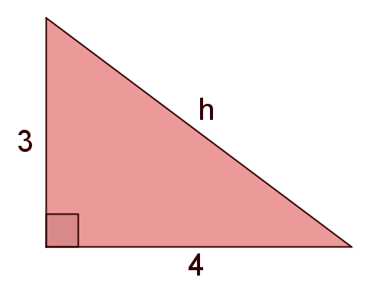

24
7
30
Date
Pythagoras Theorem
EQ – How do I use Pythagoras theorem to find the lengths in a right angled triangle?
Pythagoras Thorem states
$$a^{2}+b^{2}=c^{2}$$
e.g Find h
5

Slide 8

24
7
30
Date
Pythagoras Theorem
EQ – How do I use Pythagoras theorem to find the lengths in a right angled triangle?
Pythagoras Thorem states
$$a^{2}+b^{2}=c^{2}$$
e.g Find h
$$a^{2}+b^{2}=c^{2}$$
5

Slide 9
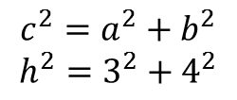
24
7
30
Date
Pythagoras Theorem
EQ – How do I use Pythagoras theorem to find the lengths in a right angled triangle?
Pythagoras Thorem states
$$a^{2}+b^{2}=c^{2}$$
e.g Find h
$${c^{2}=a}^{2}+b^{2}$$
$$h^{2}=3^{2}+4^{2}$$
5

Slide 10
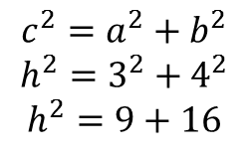
24
7
30
Date
Pythagoras Theorem
EQ – How do I use Pythagoras theorem to find the lengths in a right angled triangle?
Pythagoras Thorem states
$$a^{2}+b^{2}=c^{2}$$
e.g Find h
$${c^{2}=a}^{2}+b^{2}$$
$$h^{2}=3^{2}+4^{2}$$
$$h^{2}=9+16$$
5

Slide 11
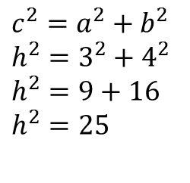
24
7
30
Date
Pythagoras Theorem
EQ – How do I use Pythagoras theorem to find the lengths in a right angled triangle?
Pythagoras Thorem states
$$a^{2}+b^{2}=c^{2}$$
e.g Find h
$${c^{2}=a}^{2}+b^{2}$$
$$h^{2}=3^{2}+4^{2}$$
$$h^{2}=9+16$$
$$h^{2}=25$$
5

Slide 12
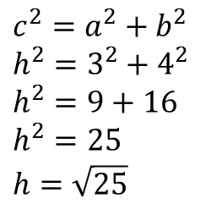
24
7
30
Date
Pythagoras Theorem
EQ – How do I use Pythagoras theorem to find the lengths in a right angled triangle?
Pythagoras Thorem states
$$a^{2}+b^{2}=c^{2}$$
e.g Find h
$${c^{2}=a}^{2}+b^{2}$$
$$h^{2}=3^{2}+4^{2}$$
$$h^{2}=9+16$$
$$h^{2}=25$$
$$h=\sqrt{25}$$
5

Slide 13
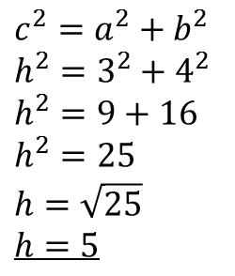
24
7
30
Date
Pythagoras Theorem
EQ – How do I use Pythagoras theorem to find the lengths in a right angled triangle?
Pythagoras Thorem states
$$a^{2}+b^{2}=c^{2}$$
e.g Find h
$${c^{2}=a}^{2}+b^{2}$$
$$h^{2}=3^{2}+4^{2}$$
$$h^{2}=9+16$$
$$h^{2}=25$$
$$h=\sqrt{25}$$
$$h=5$$
5

Slide 14
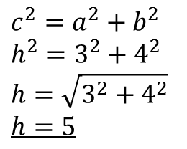
24
7
30
Date
Pythagoras Theorem
EQ – How do I use Pythagoras theorem to find the lengths in a right angled triangle?
Pythagoras Thorem states
$$a^{2}+b^{2}=c^{2}$$
e.g Find h
$${c^{2}=a}^{2}+b^{2}$$
$$h^{2}=3^{2}+4^{2}$$
$$h=\sqrt{3^{2}+4^{2}}$$
$$h=5$$
5

Slide 15
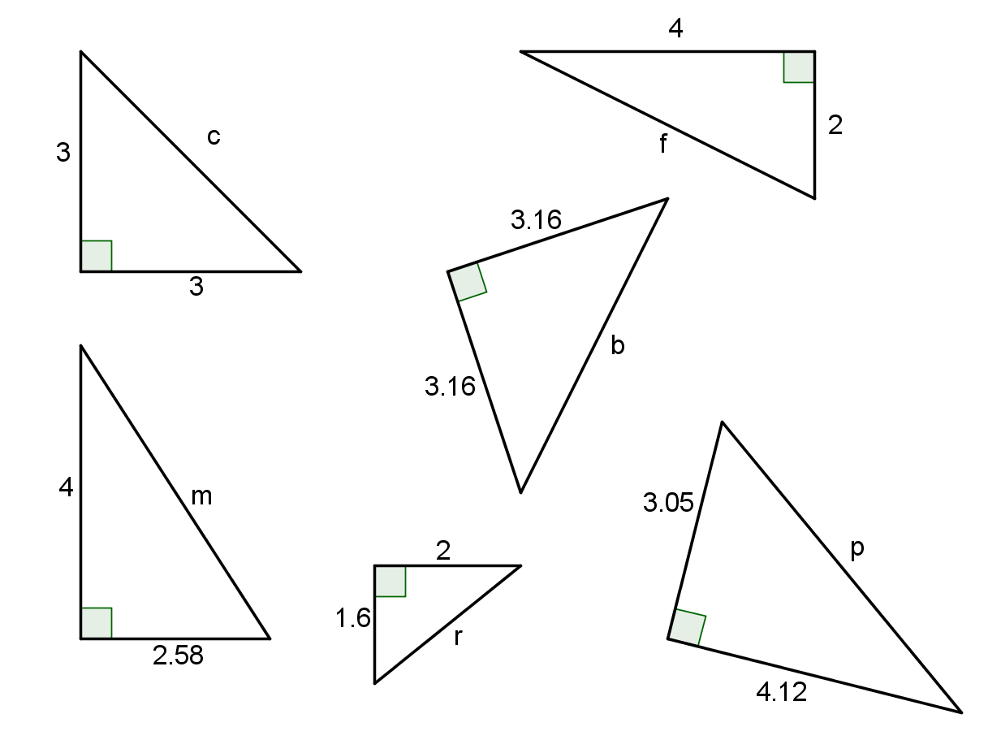
Find the value of the pronumeral

Slide 16
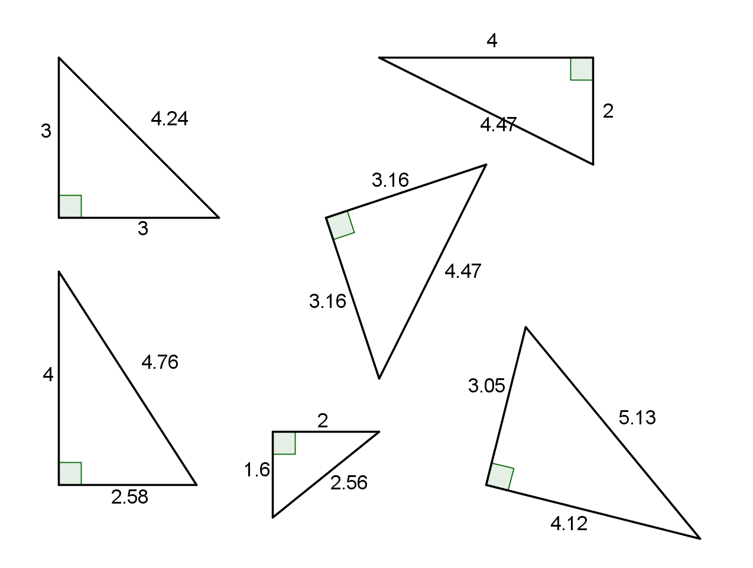
Find the value of the pronumeral

Slide 17
Questions

Slide 18
24
7
30
Date
Pythagoras Theorem
EQ – How do I use Pythagoras theorem to find the lengths in a right angled triangle?
The longest side in a right angled triangle is called the hypotenuse. (Opposite the right angle)
What is the hypotenuse?
Hypotenuse
Pythagoras Theorem states
What is Pythagoras’s Theorem?
$$a^{2}+b^{2}=c^{2}$$
5

Slide 19
24
7
30
Date
Pythagoras Theorem
EQ – How do I use Pythagoras theorem to find the lengths in a right angled triangle?
What is Pythagoras’s Theorem?
Pythagoras Thorem states
$$a^{2}+b^{2}=c^{2}$$
Example
e.g Find h
$${c^{2}=a}^{2}+b^{2}$$
$$h^{2}=3^{2}+4^{2}$$
$$h=\sqrt{3^{2}+4^{2}}$$
$$h=5$$
5

Slide 20
Notes Review
24, 7 ,30
Date
Title
Essential question
Notes complete
Notes complete with colour and diagrams
Questions completed
Contents page filed in
Formula page filled in

Slide 21
Homework
Review your notes and write a summary answering the essential question.

Slide 22
Plenary
Draw three shapes with a perimeter of 36cm.

